Slide 1
Deterministic Finite Automaton for Scalable Traffic Identification: the Power of Compressing by Range
Authors: Rafael Antonello, Stenio Fernandes, Djamel Sadok, Judith Kelner, Geza Szabo
Publisher: NOMS(Network operations and management symposium), 2012
Present: Pei-Hua Huang
Date: 2014/12/24
Department of Computer Science and Information Engineering
National Cheng Kung University, Taiwan R.O.C.
Notes:
1

Slide 2
INTRODUCTION
Decreasing the complexity of matching procedures and reducing the memory consumption of DFAs are the main goals of research studies in this field
RCDFA(Ranged Compressed DFA) is based on the following key observation: several consecutive transitions lead to the same destination state
Smart transition representations result in huge space savings over a standard DFA

Slide 3
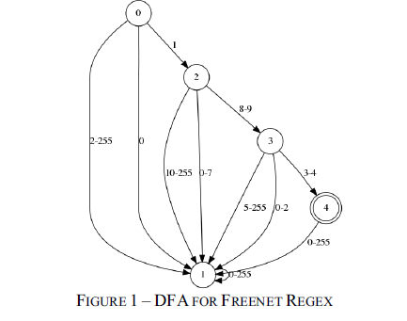
Motivational Example
Suppose the DFA created for ^\x01[\x08\x09][\x03\x04] uses the ASCII table as its input alphabet, it has 5 * 256 = 1280 transitions

Slide 4
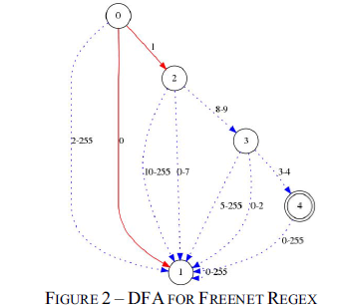
Converting DFA to RCDFA
Separating the traditional transitions from the ranged transitions decreased the number of transitions from 1280 to 2 regular transitions and 8 ranged transitions

Slide 5
DFA and RCDFA Equivalence
New machine represents consecutive transitions going to the same destination state as a unique ranged transition
tm-n => ql for character ranges cm…cn , where n ≥ m and δ (qi , cj) = ql
Q is the finite set of states, Σ is a finite set of input symbols, δ_{rcdfa}(s_{i}, (c_{m}, c_{n})) = δ_{dfa}(s_{i,} c_{j}) ∀s ∈ Q and c ∈ Σ for j varying from m to n where n ≥ m

Slide 6
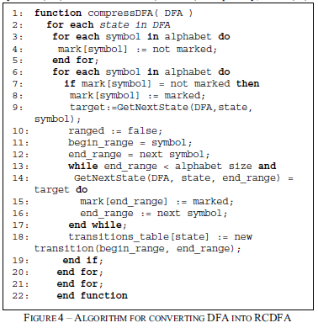
Converting DFA to RCDFA

Slide 7
Combining Models
RCDFA is orthogonal and very suitable for default transitions’ based models
RCDFA can be applied over D²FA and Fast Compression with minor adaptations

Slide 8
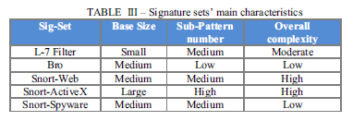
EXPERIMENTAL RESULTS

Slide 9
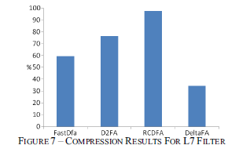
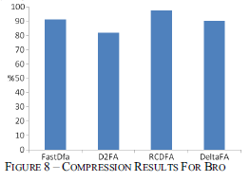
EXPERIMENTAL RESULTS

Slide 10
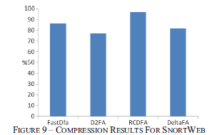
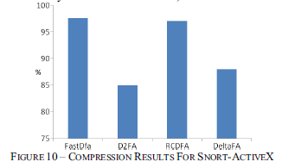
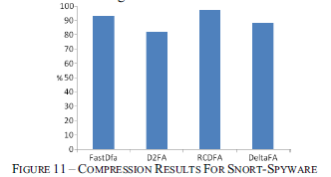
EXPERIMENTAL RESULTS

Slide 11





EXPERIMENTAL RESULTS

Slide 12

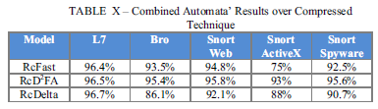
EXPERIMENTAL RESULTS

